Slide 1
Botnet Detection with Ensemble Machine Learning Method
Research Proposal progress Report
Thanawat Tejapijaya
13/7/2023

Slide 2
Content
Background
What Have I tried
Research Proposal
Objective
Methodology
Experience
Future Work

Slide 3
Background

Slide 4
My Interest
Botnet

Slide 5
What is botnet
Botnet is a network of computer that get infected by malware and under control of a single attack party without owner’s knowledge.
The word botnet came from robot and network
Life Cycle of Botnet
Injection
Command & Control Server
Upgrading & Maintenance
Maintain active botnet and spreading new botnet
Inject malware to the network
Download script and active the botnets

Slide 6
Why botnet?
Some botnet can be easily to detect by SIEM or with our eyes BUT most of it evolved and adapted their behavior to bypass SIEM
Especially, Legacy System such as insecure IoT device, Bank, Hospital etc.

Slide 7
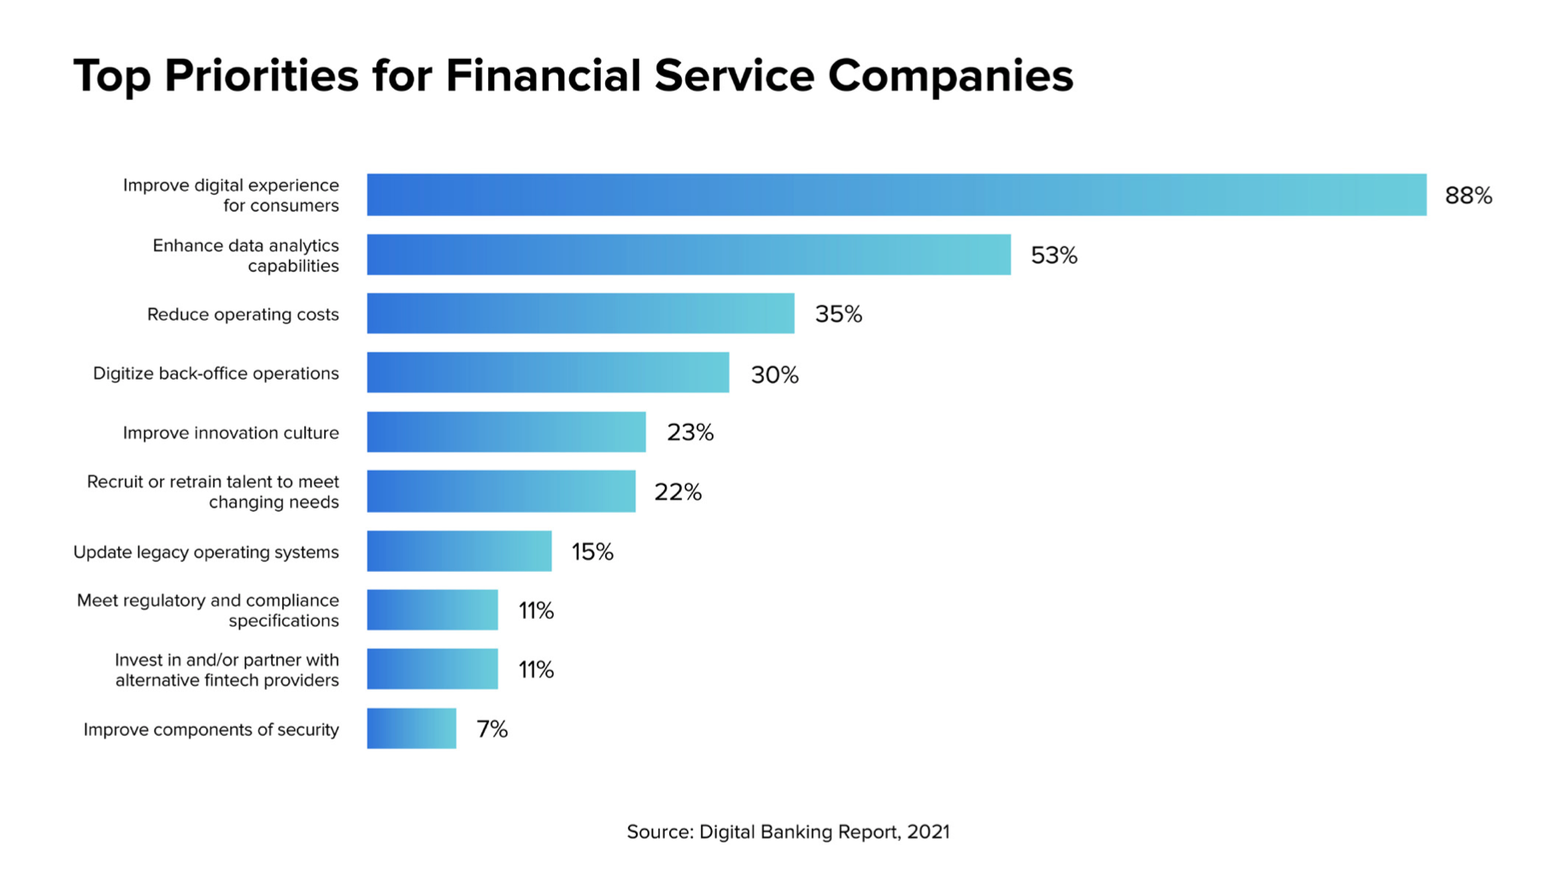
Picture from https://www.mx.com/blog/digital-experience-banks-top-priority/

Slide 8
Why botnet? (2)
History of botnet attack
Mirai Botnet 2016 – First botnet attack to target IoT device, infected over 600k insecure IoT device, Still mutating!
3ve 2018 – evaded detection and first detected by HUMAN, infected over 700k PC, compromised over 1 million ip addresses
As Botnet attack has become very challenge to detect such as 3ve due to it’s fast, massive and can evolve from time to time, that is why we need Machine Learning to help detect it due to Machine Learning is fast and have a chance to detect it before it’s too late.
https://lunio.ai/blog/ad-fraud/3ve-botnet/ https://www.humansecurity.com/learn/blog/9-of-the-most-notable-botnets

Slide 9
Definition
Abnormal Flows mean Every Botnet Attack Flows
Normal Flows mean Every Flows that isn’t botnet

Slide 10
What have I tried?

Slide 11
Data preprocessing

Slide 12
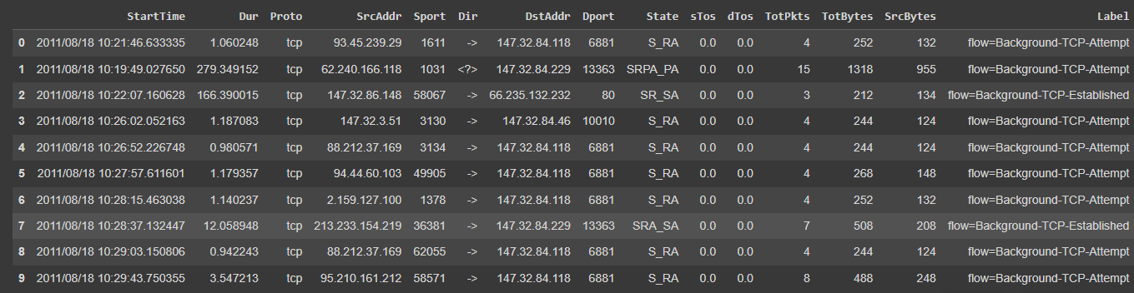
Data Preprocessing
Window width 120 seconds and slide 60 seconds^{2,3}
One window (width = 120 seconds)

Slide 13
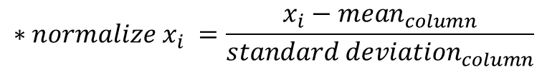
Data Preprocessing(2)
$$∗{normalize x}_{i} =\frac{x_{i}−{mean}_{column}}{{standard deviation}_{column}}$$
Feature dropped
sTos, dTos, Dir, Proto, State, TotPkts
Feature Extraction
Categorical Feature – group by source address
number of unique occurrence in subgroup and normalize*
Normalize subgroup after using Shannon Entropy¹
dropped

Slide 14
Data Preprocessing(3)
$$∗{normalize x}_{i} =\frac{x_{i}−{mean}_{column}}{{standard deviation}_{column}}$$
Numerical Feature
Sum, mean, standard deviation, maximum and median and normalize*
As a result, from 15 features dropped 5 and extracted into 22 features

Slide 15
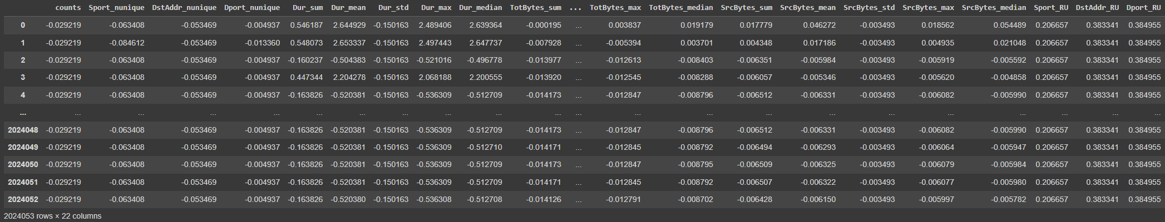
Feature After Extract (22 features)
Normalize Entropy of each column
Number of unique occurrence in subgroup

Slide 16
Training Model
Random Train and Test 13 files separately 50 times
4 Models
Logistic Regression Ridge
Random Forest
Support Vector Machine (SVM)
Long Short Term Memory (LSTM)

Slide 17
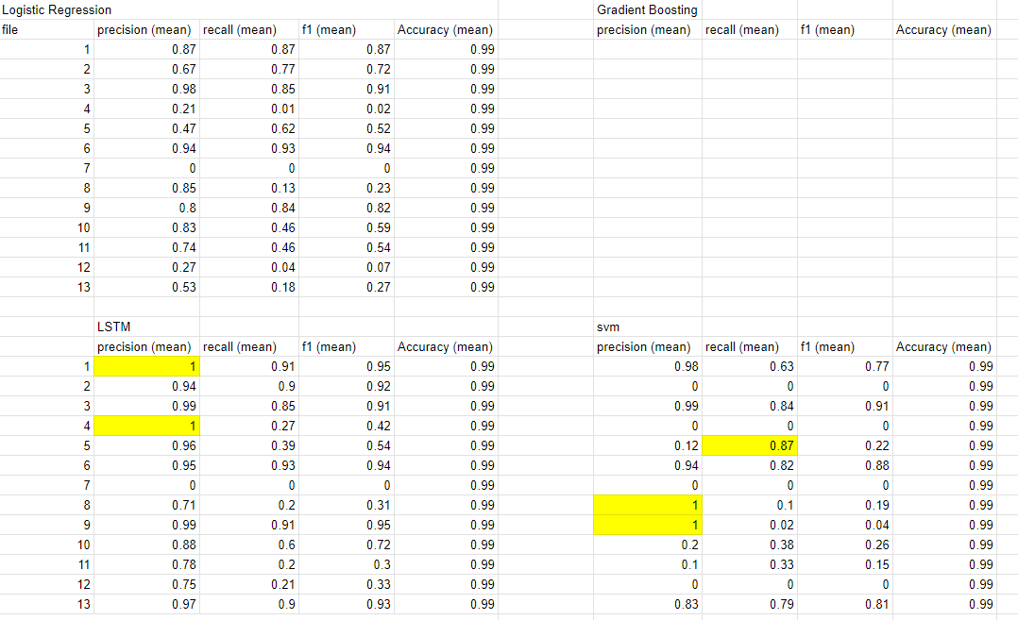
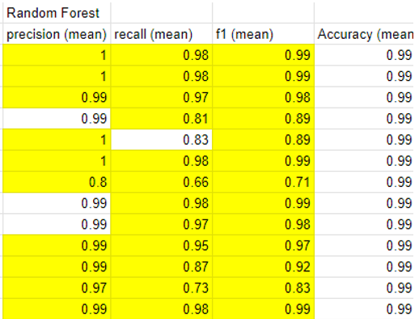
Result (Test Separately)

Slide 18
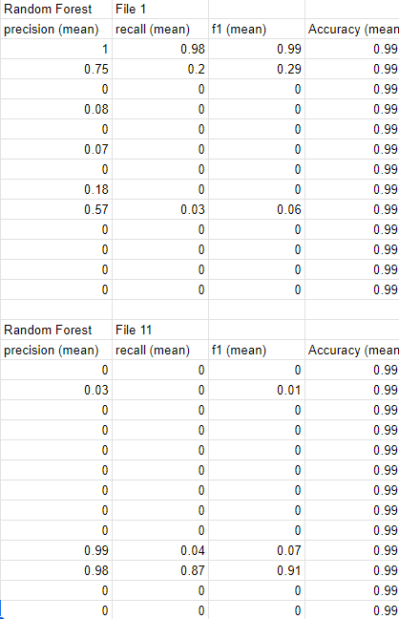
Result(When use one dataset to train and test with others)

Slide 19
Botnet Detection with Ensemble Machine Learning Method

Slide 20
Research Objective
Find a robust model for detecting botnet

Slide 21
Methodology
Logistic Regression
SVM
Gradient Boosting
Random Forest
LSTM
dataset
Data Preprocessing
Train & Test each file separately
CTU 13 dataset
Shannon Entropy
one hot encoder
BClus Method
Ensemble technique
Bagging
Boosting
Stacking
Evaluation
F1 score, precision , recall

Slide 22
Future Work
Continue writing research proposal
Data preprocessing

Slide 23
Thank you

